Slide 1


Building Interactive Web Apps Using the JavaScript API's Geometry Engine
Esri Developer Summit
March 8–11, 2016 | Palm Springs, CA
Kristian Ekenes and David Bayer
Notes:
[KRISTIAN]

Slide 2


Session Goals
Overview of the Geometry Engine
What operations are available with the Geometry Engine?
How to Use the Geometry Engine
How to start coding with the Geometry Engine
When to use the Geometry Engine
Where will it make a difference to your app
Notes:
In this talk, we are going to give an overview of the ArcGIS Javascript APIs geometry Engine.
This engine was incorporated into the API last year, and provides a lot of scope for making certain types of applications much more interactive.
We are going to through the type of operations that exist in the Geometry Engine, then look at how to actually make calls to the geometry engine, before finally looking at why you may want to use it, and when not to use it.

Slide 3
Geometry
Points, Lines, Polygons, Multipoints, …
Notes:
Geometry…. Points, Lines, Polygons, Multi Points.
As we all know Geometry is fundamental to GIS. Features on the ground are represented as geometric shapes, with real world coordinates.
The relationships between these shapes is how spatial analysis works. Understanding whether geometries overlap, what the intersection between shapes are, the distance between features.
The geometry engine in the Javascript API, allows you to do these types of operations in your web apps, running in the browser.
So what kind of operations can you do?

Slide 4
Geometry Engine: what is it?
Touches
Geometry Relationships
Overlaps
Crosses
Equals
Within
Intersects
Orchards Demo
Notes:
There are lots of methods in the GeometryEngine. Possibly the most useful, are the relationship tests you can do with the Geometry Engine.
These relationship tests, will tell you whether geometries overlap each other, if they intersect each other, cross, touch, are equal, etc.
All of these operations, work with the Spatial Tolerance of the data. So this means that functions such as equal, will tell you if two shapes are the same, even if they are have very slight mathematical differences in coordinates, which are below the tolerance of the coordinate system.
If we look at a quick demo of those operations…
It is also worth noting, that these operations work across the different geometry types, so you can test whether a line crosses a polygon, or whether a line crosses another line.

Slide 5
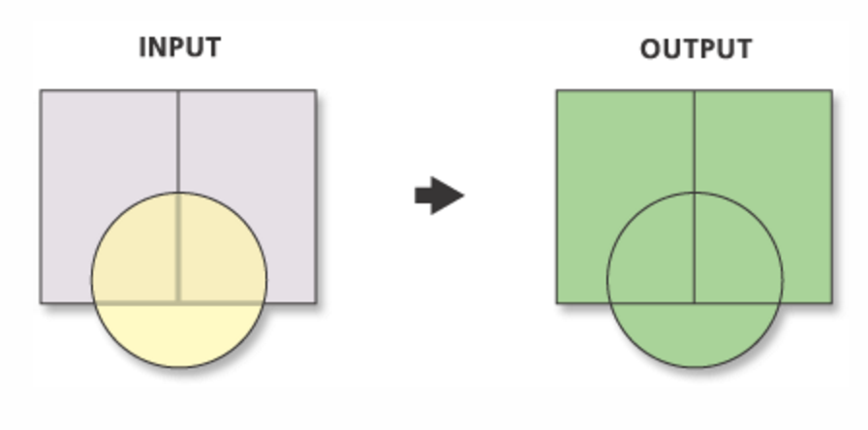
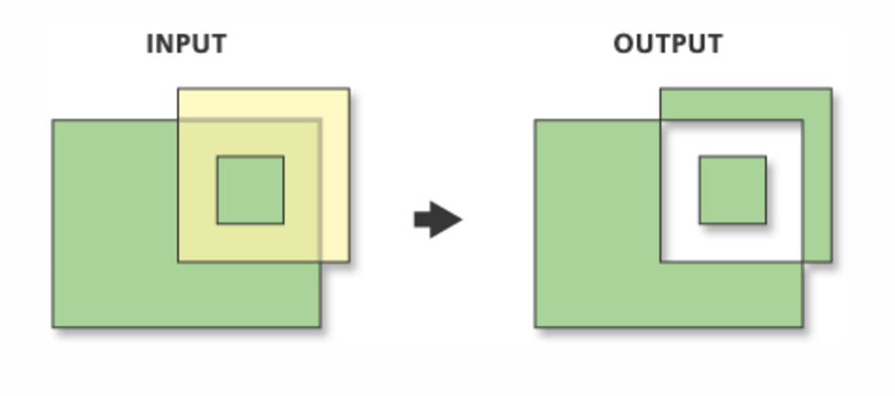
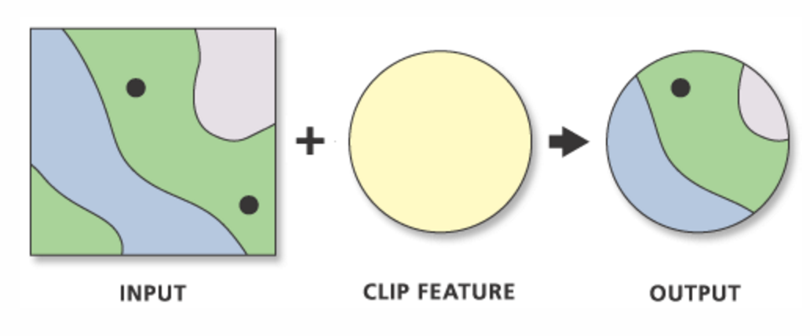
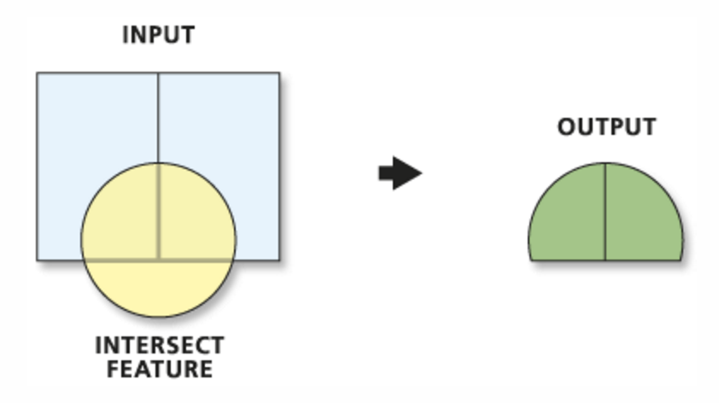
Geometry Engine: what is it?
Geometry Algebra/Overlay operations
Union
Symmetric Difference
Clip
Intersection
Utah land demo
Notes:
Understanding the relationships between geometries is useful, but very often in applications you need the actual intersection geometry between shapes, or you need to clip shapes, union shapes. These are typically used for overlay operations.
The geometry Engine, allows you to do this kind of operation as well.

Slide 6
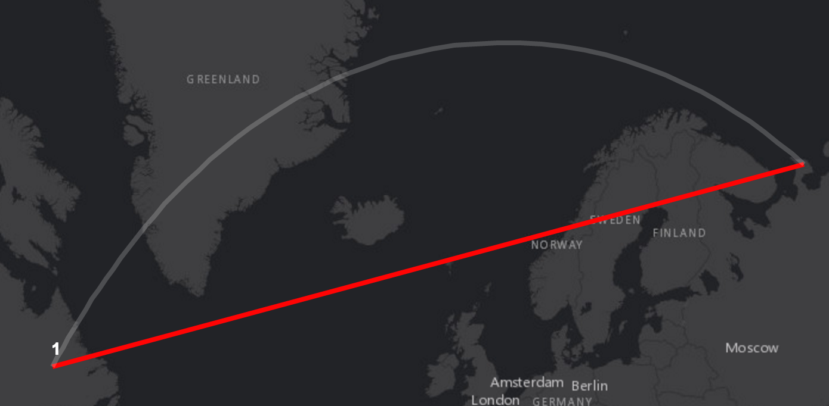
Geometry Engine: what is it?
Distances and Measurements
geodesicLength
planarLength
geodesicArea
planarArea
geodesic and planar measurement demo
Notes:
There are also other kinds of operations… distances and measurements.. What is the distance between two points, or the length or area of a line.
The geometry Engine gives you the ability to calculate planar lengths and areas for features.
Also importantly, it gives you the ability to do geodesicLengths and geodesic areas. [If you are in WebMercator].. It is worth pointing out, that the geometry engine does not have projection engine. If you need to do projection you will need to use server side calls.

Slide 7
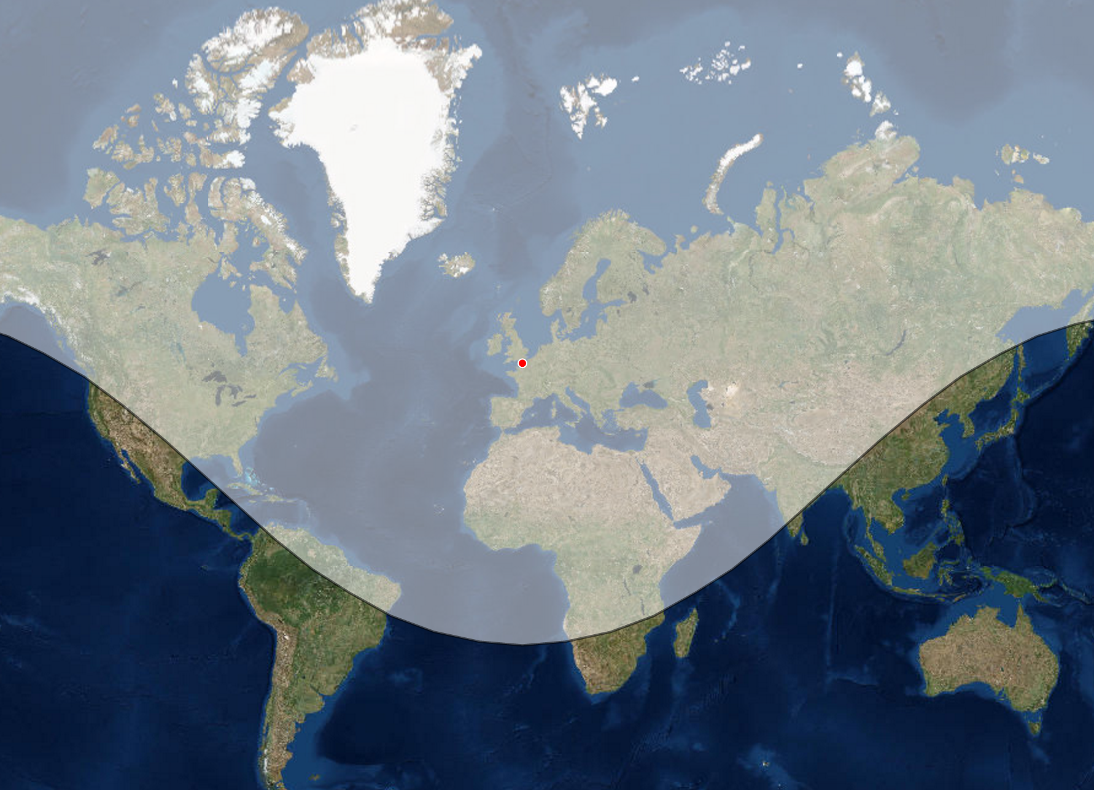
Geometry Engine: what is it?
geodesicBuffer
Other Operations
Rotate
Flip
Convex Hull
IsSimple
Buffer
Geodesic Buffer
Generalize
Densify
Simplify
Notes:
There are many more methods in the geometry engine…
Buffering, and Geodesic Buffering allows you to grow and shrink geometries.
Generalize and Densify, allow you increase or reduce the number of vertices in your geometries.
IsSimple and Simplify allow you to fix issues with your geometry, and make them legal. This allows you to fix geometry that is not topologically correct, say if it has self intersecting lines

Slide 8
I can do this already….
It’s called the Geometry Service!
Notes:
[DAVID]
I suspect some of you are thinking that this is not new. These operations have been possible with all the ESRI API’s for quite a while.
In the Javascript API, you have always been able to do these operations, just by calling the ESRI Geometry Service.
The Javascript API, has the GeometryService Task to do these exact type of operations and more!

Slide 9
User Experience: Interactivity
Geometry Service REST Call
Encoding
Geometry
as JSON
5ms
Sending Request over Network
200+ ms
Running Geometry
Operation
100+ ms
Sending Response back
over Network
200+ ms
Decoding
Response
5ms
Notes:
So what is the difference…
The Geometry Service, requires you to make a REST Call
The geometry involved in the operation is converted to JSON, sent over the wire to the Geometry Service. The geometry service runs its logic, and sends the results back over the wire.
This is 500ms + for every operation… For poor networks, or large payloads even longer.
Interactive UX is measured in <300ms

Slide 10
User Experience: Interactivity
Geometry Engine API Call
Running Geometry Operation
200+ ms
Notes:
The key difference, is that the Geometry Engine is client side, all the operations are running in the browser. This means that you can give a very different user experience to your users, and it opens up a wide range of apps that aren’t possible.

Slide 11
Demo
How many REST calls can I save?
Buffer 500 points: GeometryEngine vs GeometryService
Orchards demo: number of GS requests avoided
Notes:
Purpose of DEMO, is cool demo, showing on the fly, splitting, cutting, area etc

Slide 12
Let’s get to the Code
How do I start using the Geometry Engine in my App
Notes:
----- Meeting Notes (3/10/16 13:20) -----

Slide 13
GeometryEngine
Calling Operations on the Geometry Engine
require( [ “esri/geometry/geometryEngine” ],
function( geometryEngine ) {
var buffer = geometryEngine.buffer(mapPoint, 10, “miles”);
var within = geometryEngine.within(buffer, utahBoundary);
var overlaps = geometryEngine.overlaps(buffer, utahBoundary);
if (!overlaps && !within) {
console.log(“Buffer is outside Utah boundary!”);
} else if (overlaps && !within) {
var partialBuffer = geometryEngine.intersect(buffer, utahBoundary);
}
});
Notes:
AMD the Module,
Call the Operation

Slide 14
Asynchronous Patterns
Uses Deferred Pattern
require( [ “esri/geometry/geometryEngineAsync” ],
function( geometryEngineAsync ) {
geometryEngineAsync.buffer(mapPoint, 10, “miles”).then( function(buffer) {
},
function(erre) {
});
});
Notes:
AMD the Module,
Call the Operation

Slide 15
When to Use the GeometryEngine
When will it make a difference to my App

Slide 16
Geometry Engine: Trade-offs
Trade-off between Geometry Service and Geometry Engine
Large AMD download for Geometry Engine
versus
Network latency and round trip cost of Geometry Service
Other Considerations: Apps Requirements
Unsupported operations : projections
Frequency of calls : user interactivity
Offline or poor network connection
Ease of coding

Slide 17
Geometry Engine Resources
Documentation, Blogs, Samples
Notes:
[KRISTIAN]

Slide 18
Resources
Documentation
https://developers.arcgis.com/javascript/jsapi/esri.geometry.geometryengine-amd.html
https://developers.arcgis.com/javascript/jsapi/esri.geometry.geometryengineasync-amd.html
Blogs
Testing spatial relationships and editing
Measurement
Overlay analysis
Deep Dive Session
A Deep Dive on How the Geometry Engine Can Help You Build Better Apps
Friday 10.00 AM – 11:00 AM
Primrose C/D

Slide 19




